Slide 1
Decision Tree
Anuj Jain

Slide 2
Outline:
Classification and Regression
Classification Types
Decision tree and examples
ID3 Algorithm
CART

Slide 3
Classification and Regression
It predicts the values for the target features for new example or data .
For X -> Y if Y is discrete then know as classification.
Ex 1. Predicts whether the rain or not?
Ex 2. Email filter is able to classify whether the given email is spam or non- spam.
For X -> Y if Y is Continuous then know as regression.
Ex. Predict price of house (some real value)

Slide 4
Classification use cases
Banking:
Identification of loan risk applicants based on his income or saving.
Medicine:
Identification of at-risk patients and disease trends.

Slide 5
Types of classifier
Decision Tree
Random Forest
Naïve Bayes

Slide 6
Decision Tree
Decision tree builds classification models in the form of tree structure.
It breaks down dataset into smaller and smaller subsets.
Two types of nodes:
Decision Nodes: specifics test or choices
Leaf Nodes: Indicates classification of an example or value of the example.

Slide 7
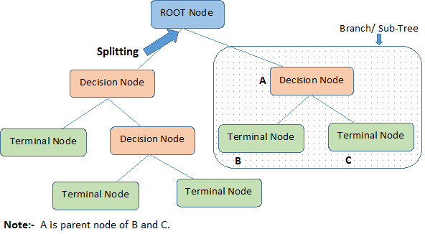

Slide 8
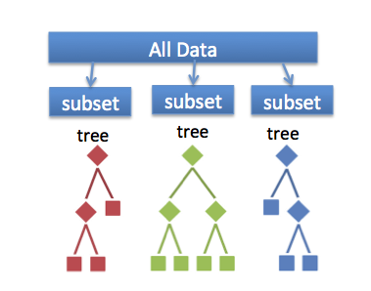
Random Forest
- It is an ensemble classifier made using many decision tree models.
- Ensemble models combine the results from different models.

Slide 9
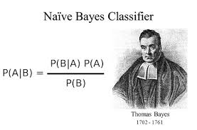
Naïve Bayes
- It’s a classification technique based on Bayes theorem with an assumption of independence among attributes.

Slide 10
Example
EX 1. Whether to approve a loan or reject loan?
If(employed == True)
{
if(Income >=50000)
{ print(‘Loan Approved’)}
else
{print(‘Loan Rejected’)}
}
Else
{
if(saving>=2500000)
{ print(‘Loan Approved’)}
else
{ print(‘Loan Rejected’)}
}

Slide 11
Decision Tree of Ex 1.:
Employed?
No
Yes
Saving?
Income?
>=2500000
<2500000
<50000
>=50000
Approve
Reject
Approve
Reject

Slide 12
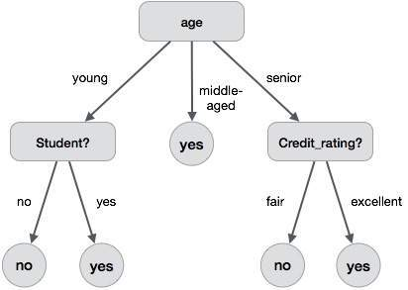
Ex 2. Whether the person likely to buy a computer or not?

Slide 13
Ex 3. Based on weather information should one can go outside for play or not?
Day | Outlook | Humidity | Wind | Decision
D1 | Sunny | High | Weak | No
D2 | Sunny | High | Strong | No
D3 | overcast | High | Weak | Yes
D4 | Rain | High | Weak | Yes
D5 | Rain | Normal | Weak | Yes
D6 | Rain | Normal | Strong | No
D7 | Overcast | Normal | Strong | Yes
D8 | Sunny | High | Weak | No
D9 | Sunny | Normal | Weak | Yes
D10 | Rain | Normal | Weak | Yes
D11 | Sunny | Normal | Strong | Yes
D12 | Overcast | High | Strong | Yes
D13 | Overcast | Normal | Weak | Yes
D14 | Rain | High | Strong | No

Slide 14
Outlook = Rain
Humidity=High
wind=Weak
Decision =?

Slide 15
From our data we choose one variable “outlook” and see it’s affects on the variable “play”
Play : 9 yes, 5 no
Outlook
Sunny
Overcast
Rain

Slide 16
Outlook
Sunny
Overcast
Rain
Day | Outlook | Humidity | Wind
D3 | Overcast | High | Weak
D7 | Overcast | Normal | Strong
D12 | Overcast | High | Weak
D13 | Overcast | Normal | strong
Will play
Day | Outlook | Humidity | Wind
D1 | Sunny | High | Weak
D2 | Sunny | High | Strong
D8 | Sunny | High | Weak
D9 | Sunny | Normal | Weak
D11 | Sunny | Normal | Strong
Day | Outlook | Humidity | Wind
D4 | Rain | High | Weak
D5 | Rain | Normal | Weak
D6 | Rain | Normal | Strong
D10 | Rain | Normal | Weak
D14 | Rain | High | strong

Slide 17
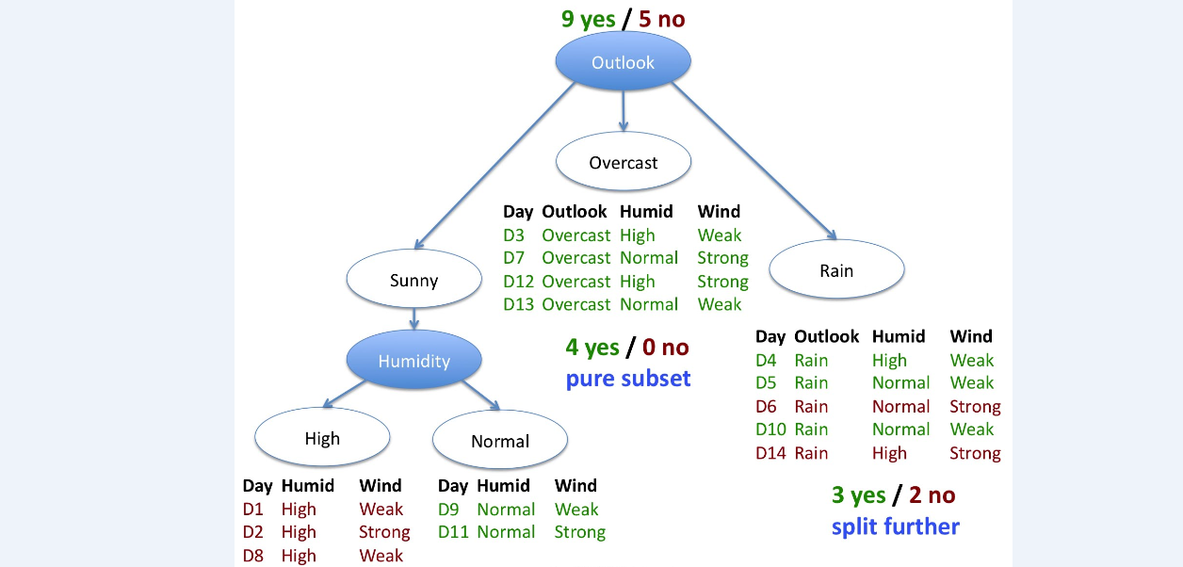

Slide 18
Outlook
Sunny
Overcast
Rain
Will play
Humidity
High
Normal
Will not play
Will play
Wind
Weak
strong
Day | Humidity | wind
D4 | High | Weak
D5 | Normal | Weak
D10 | Normal | Weak
Day | Humidity | wind
D6 | Normal | Strong
D14 | High | Strong

Slide 19
Outlook
Sunny
Overcast
Rain
Will play
Humidity
High
Normal
Will not play
Will play
Wind
Weak
strong
Will play
Will not play

Slide 20
Decision tree Algorithm
ID3 (iterative Dichotomiser 3)
CART (classification and regression tree)
C4.5 (Successor of ID3)
MARS (extends decision tree to handle numerical data better)

Slide 21
ID3 Algorithm
Dichotomisation means dividing into two completely opposite things.
Algorithm iteratively divides attributes into according to the attribute values.
Then it calculates the Entropy and information gains of each attribute. In this way the most dominant attribute can be founded that will become the root node of the decision tree.
Entropy and gain scores would be calculated again among the other attributes.
Procedure continues untill reaching a decision for that branch.

Slide 22
How to choose an attribute?
A common way to identify the most informative attribute is to use entropy-based methods.
Entropy is a measure of disorder in the data or measure of uncertainty in data.
Entropy low when all or all most data at one node are either positive or negative.
Entropy highest when half are positive and half are negative.

Slide 23
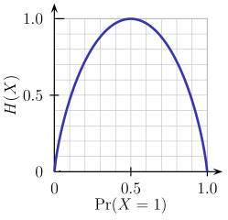
Entropy can be calculated as,
Entropy(s)= - P+ (log 2 P+) – P- (log 2 P-)
Where P+ is no of data classified as positive label from total available data
Where P- is no of data classified as negative label from total available data

Slide 24
Information gain(S, A) of an attribute A is defined as the difference between the base entropy and the conditional entropy of the attribute.
S= Sample data
A= with respect to attribute A
Gain (S, A) = Entropy(S)- ∑ (Sv/ S)
Vє value(A)
Note: choose attribute whose information gain is highest.

Slide 25

Calculation
Entropy(Decision)=0.940
Information gain(Decision , outlook)= 0.2446
Information gain(Decision , humidity)= 0.1522
Information gain(Decision , wind)= 0.0445
Outlook become the root node.

Slide 26
CART Algorithm
CART uses Gini Index for attribute selection.
It measures the impurity of D, a data partition or set of training tuples.
Gini(D) = 1 - ∑ (Pi)²
^{i=1}
where P_{i} is the probability that a tuple in D belongs to class Ci.
Attribute whose impurity is less will be selected.

Slide 27
It uses binary split of each attribute.
If attribute A has V possible values then there are 2^{v} possible subsets. We will consider only 2^{v} - 2 subsets.
We exclude the power set and empty set because they do not represent a split.
EX. Income – {Low, medium, high}
{low, medium}, {medium , high}, { high , low} , {low}, {medium}, {high}

Slide 28

Find the impurity of label attribute in D, using
Gini(D) = 1 - ∑ (Pi)²
^{i=1}
Find the impurity of each resulting partition using
Find reduction in impurity using formula
Select the best attribute which gives the minimum Gini index or maximizes the reduction in impurity.

Slide 29
Ex 4.
RID | Age | Income | Student | Credit_rating | Buy_computer
1 | Youth | High | No | Fair | No
2 | Youth | High | No | Excellent | No
3 | Middle_aged | High | No | Fair | Yes
4 | Senior | Medium | No | Fair | Yes
5 | Senior | Low | Yes | Fair | Yes
6 | Senior | Low | Yes | Excellent | No
7 | Middle_aged | Low | Yes | Excellent | Yes
8 | Youth | Medium | No | Fair | No
9 | Youth | Low | Yes | Fair | Yes
10 | Senior | Medium | Yes | Fair | Yes
11 | Youth | Medium | Yes | Excellent | Yes
12 | Middle_aged | Medium | No | Excellent | Yes
13 | Middle_aged | High | Yes | Fair | Yes
14 | Senior | Medium | No | Excellent | No

Slide 30


Calculation
{low , medium} or
{high}

Slide 31
Attribute | Split | Gini index | Reduction_impurity
Income | {medium , high} or {low} | .300 | .459-.300=.159
Age | {youth , senior} or {middle_Aged} | .375 | .459-.375=.084
Student | Binary | .367 | .459-.367=.092
Credit_rating | Binary | .429 | .459-.429=.03

Slide 32
Ex 5. Develop decision tree for the following data set.
Color | Diameter | Label
Green | 3 | Apple
Yellow | 3 | Apple
Red | 1 | Grape
Red | 1 | Grape
Yellow | 3 | Lemon

Slide 33
Is Diameter >=3?
Red 1 Grape
Red 1 Grape
Predict Grape 100%
Green 3 Apple
Yellow 3 Apple
Yellow 3 Lemon
Is color =yellow?
Green 3 Apple
Yellow 3 Apple
Yellow 3 Lemon
Predict Apple 50% Lemon 50%
Predict Apple 100%
False
True
False
True

Slide 34
Issues In Decision tree
Given some training example, many decision tree should be generated.
One Proposal: Prefer the smallest tree (low depth or less nodes) that is consistent with the data.

Slide 35
Decision Tree-Pros
Computationally inexpensive.
Handles both numerical & categorical attributes.
Decision tree is easy to implement in any procedural language because it follows the simple if else condition structure and Outputs are easy to interpret.
Sensitive to small variations in the training data.
Robust with redundant or correlated variables.

Slide 36
Thank You

